Slide 1
STOR 455 Class 34
Read: 5.1 – 5.4
Exercises: 5.27, 37, 38, 40

Slide 2
Quantitative vs. Categorical
We could investigate this relationship several ways:
1. Y = Quantitative; X = Categorical
⇒ “dummy” regression
2. Y = Binary Categorical; X = Quantitative
⇒ logistic regression
3. Difference in two means
⇒ two-sample t-test
4. Difference in more than two means
⇒ ANOVA for means

Slide 3
ANOVA for Difference in K Means
Data: Samples from K different groups
Summary statistics:
For each group
Combine all
Test: H_{o}: μ₁ = μ₂=...= μ_{K}
H_{a}: Some μ_{i} ≠μ_{j}

Slide 4
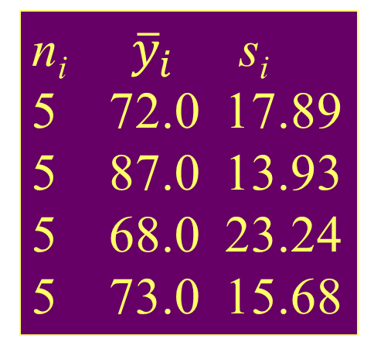
Example: Four Exams
n_{i} ${\overline{y}}_{i}$ s_{i}
5 72.0 17.89
5 87.0 13.93
5 68.0 23.24
5 73.0 15.68
Exam #1:
Exam #2:
Exam #3:
Exam #4:
62, 94, 68, 86, 50
87, 95, 93, 97, 63
74, 86, 82, 70, 28
77, 89, 73, 79, 47
Overall 20 75.0 18.11
Is there a significant difference in average grade among the four exams?
Test: H_{o}: μ₁ = μ₂= μ₃ = μ₄
H_{a}: Some μ_{i} ≠μ_{j}

Slide 5
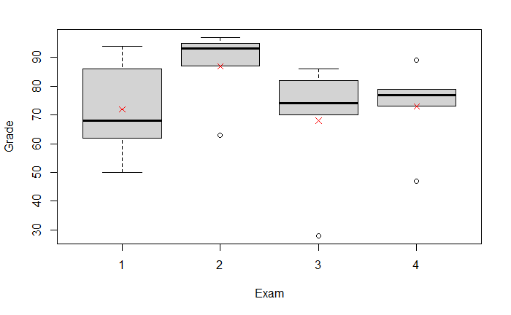
Example: Four Exams
boxplot(Grade~Exam, data=Exams4)
means = tapply(Exams4$Grade, Exams4$Exam,mean)
points(means, col = "red", pch=18)

Slide 6
ANOVA (Means) Model
Mean for Group #i
N(0,σ_{ε}) random error
Under H_{o} (μ_{i}’s all equal) ⇒
(overall mean)
Under H_{a} (μ_{i}’s differ) ⇒
(group mean)

Slide 7
“Predicting” in ANOVA Model
If the group means are the same (H₀):
for all groups ⇒
If the group means can be different (H_{a}):
for i^{th} group ⇒
Do we do “significantly” better with separate means?
Compare sums of squared residuals…
vs.

Slide 8
Partitioning Variability
=
+
Data
Model
Error
Y
=
μ_{i}
+
ε
=
+
TOTAL variation in response, Y
Variation explained by MODEL
Unexplained variation in RESIDUALS
Key question: Does the MODEL explain a “significant” amount of the TOTAL variability?

Slide 9
Partitioning Variability ANOVA for Group Means
Y
=
μ_{k}
+
ε
=
+
?
=
+
=
SSGroups
+
SSE
SSTotal

Slide 10
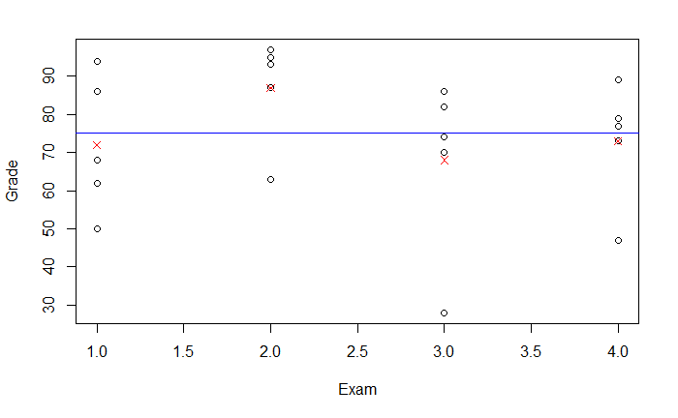
Variation Between vs Within Groups
plot(Grade ~ Exam, data = Exams4)
points(means, col="red", pch=4)
abline(h = mean(Exams4$Grade), col = "blue")

Slide 11
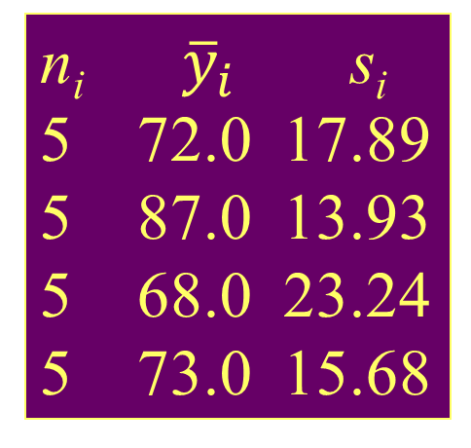
Example: Four Exams
n_{i} ${\overline{y}}_{i}$ s_{i}
5 72.0 17.89
5 87.0 13.93
5 68.0 23.24
5 73.0 15.68
Exam #1:
Exam #2:
Exam #3:
Exam #4:
62, 94, 68, 86, 50
87, 95, 93, 97, 63
74, 86, 82, 70, 28
77, 89, 73, 79, 47
Overall 20 75.0 18.11

Slide 12
ANOVA Table (for K Group Means)
H_{o}: μ₁ = μ₂= … = μ_{K}
H_{a}: Some μ_{i} ≠μ_{j}
Small P-value ➔ Reject H_{o} ➔ There is a significant difference among the means of the K groups

Slide 13
ANOVA Output in R
amodG=aov(Grade~factor(Exam),data=Exams4)
amodG
Call:
aov(formula = Grade ~ factor(Exam), data=Exams4)
Terms:
factor(Exam) Residuals
Sum of Squares 1030 5200
Deg. of Freedom 3 16
Residual standard error: 18.02776
Estimated effects may be unbalanced
summary(amodG)
Df Sum Sq Mean Sq F value Pr(>F)
factor(Exam) 3 1030.0 343.3 1.0564 0.395
Residuals 16 5200.0 325.0

Slide 14
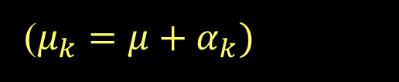
Alternate Form ANOVA Model for Means
Grand Mean
Effect for i^{th} group
Random error
($μ_{k}=μ+α_{k})$
H_{o}: μ₁ = μ₂=...= μ_{K}
H_{a}: Some μ_{i} ≠μ_{j}
⇔
H_{o}: α₁ = α₂=...= α_{K}=0
H_{a}: Some α _{i} ≠0

Slide 15
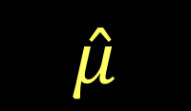
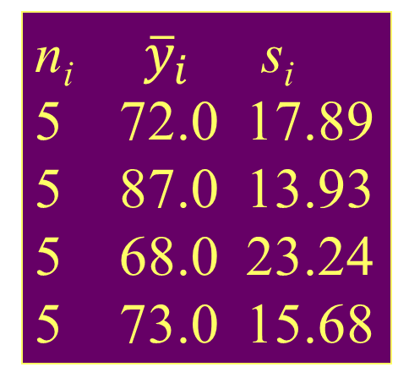
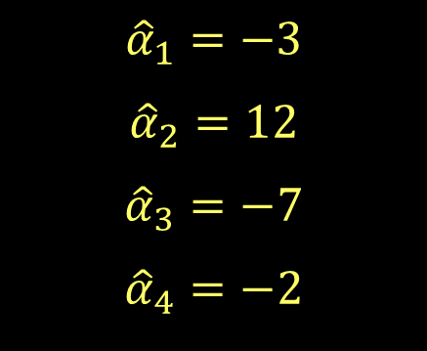
Example: Four Exams
n_{i} ${\overline{y}}_{i}$ s_{i}
5 72.0 17.89
5 87.0 13.93
5 68.0 23.24
5 73.0 15.68
Exam #1:
Exam #2:
Exam #3:
Exam #4:
62, 94, 68, 86, 50
87, 95, 93, 97, 63
74, 86, 82, 70, 28
77, 89, 73, 79, 47
$${\hat{α}}_{1}=−3$$
$${\hat{α}}_{2}=12$$
$${\hat{α}}_{3}=−7$$
$${\hat{α}}_{4}=−2$$
Overall 20 75.0 18.11
$$\hat{μ}$$

Slide 16
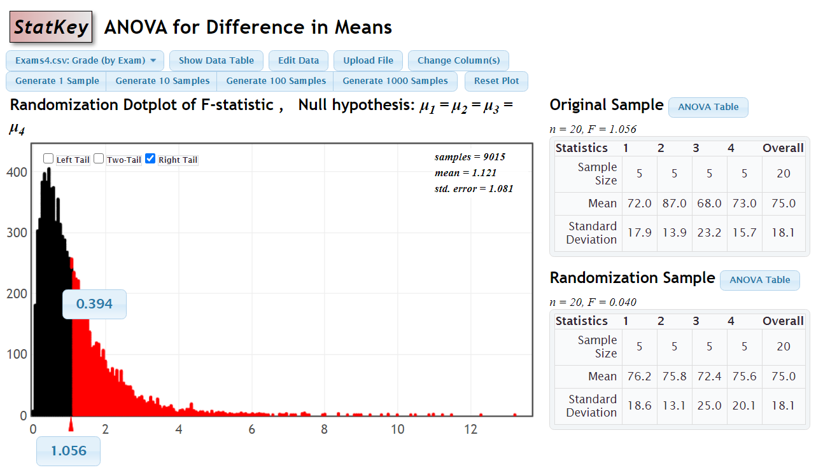

Slide 17
Checking Conditions for ANOVA
Check with residuals
Zero mean:
Always holds for sample residuals
Constant variance:
Plot residuals vs. fits and/or compare std. dev.’s of groups (Check if some group s_{i} is more than twice another).
Normality:
Histogram/normal plot of residuals
Independence:
Pay attention to data collection

Slide 18
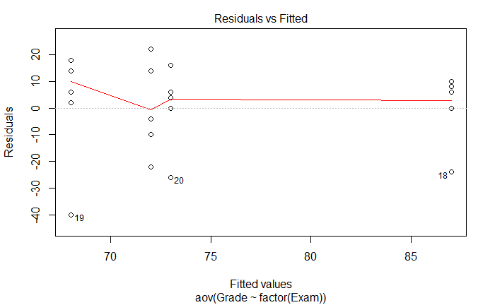
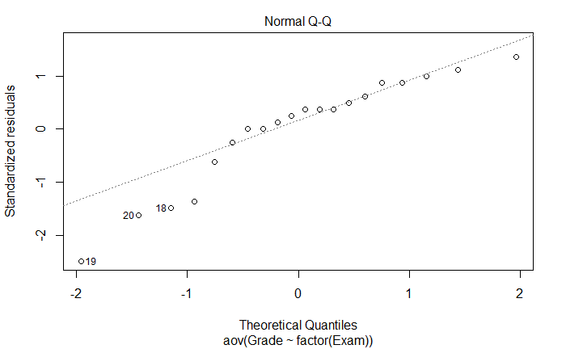
Residual Plots – Exam ANOVA
plot(amodG)
Might be a problem in this tail?

Slide 19
Example: Five Students
Barb Betsy Bill Bob Bud
Exam #1:
Exam #2:
Exam #3:
Exam #4:
62 94 68 86 50
87 95 93 97 63
74 86 82 70 28
77 89 73 79 47
Mean 75.0 91.0 79.0 83.0 47.0
Is there a significant difference in average grade among the five students?

Slide 20
ANOVA for Grades vs. Students
> tapply(Exams4$Grade,Exams4$Student,mean)
Barb Betsy Bill Bob Bud
75 91 79 83 47
> round(tapply(Exams4$Grade,Exams4$Student,sd),2)
Barb Betsy Bill Bob Bud
10.30 4.24 10.98 11.40 14.45
> modS=aov(Grade~factor(Student),data=Exams4)
> summary(modS)
Df Sum Sq Mean Sq F value Pr(>F)
Student 4 4480 1120.0 9.6 0.000468 ***
Residuals 15 1750 116.7
There is a significant difference in mean exam score between the students.
Which means are significantly different?

Slide 21
How Many Comparisons?
Example: Barb, Betsy, Bill, Bob, Bud (5 groups)
Barb vs. Betsy Barb vs. Bill Barb vs. Bob
Barb vs. Bud Betsy vs. Bill Betsy vs. Bob
Betsy vs. Bud Bill vs. Bob Bill vs. Bud
Bob vs. Bud
⇒ 10 possible comparisons

Slide 22
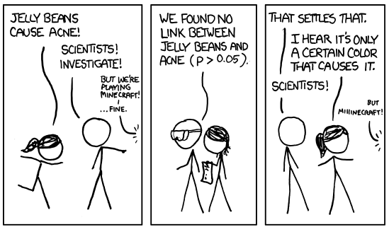
Problem of Multiplicity

Slide 23
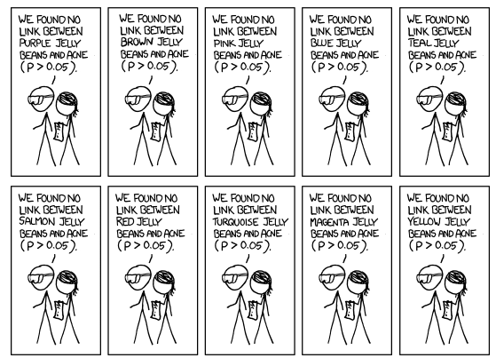
Multiple Testing

Slide 24
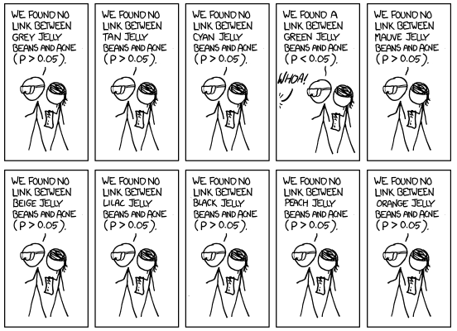
Multiple Testing

Slide 25

Multiple Testing
http://xkcd.com/882/

Slide 26
Problem of Multiplicity
When doing many pairwise comparisons
⇒ likely to make a Type I error (find a false difference)
Possible fixes:
Do only a few pre-planned comparisons
Adjust the significance level used for each test.

Slide 27
Example: Exam Scores
Barb Betsy Bill Bob Bud
Mean
72
87
68
73
75
Exam #1:
Exam #2:
Exam #3:
Exam #4:
62 94 68 86 50
87 95 93 97 63
74 86 82 70 28
77 89 73 79 47
Mean 75 91 79 83 47
We’ve shown (one-way):
No significant differences between the exams
Significant differences between the students
Question: Can we use BOTH factors to help explain the variability in the exam scores?

